Slide 1

6th Grade Math
Unit 8, Lesson 6 Volume of Right Rectangular Prisms Volume 2, pg. 102

Slide 2


Benchmark
MA.6.GR.2.3
Solve mathematical and real-world problems involving the volume of right rectangular prisms with positive rational number edge lengths using a visual model and a formula.
volume 2, pg. 102

Slide 3
Integrated Mathematical Thinking and Reasoning Standards
MA.K12.MTR.1.1 Actively participate in effortful learning both individually and collectively.
MA.K12.MTR.2.1 Demonstrate understanding by representing problems in multiple ways.
MA.K12.MTR.4.1 Engage in discussions that reflect on the mathematical thinking of self and others.
MA.K12.MTR.5.1 Use patterns and structure to help understand and connect mathematical concepts.
volume 2, pg. 102

Slide 4

Learning Target
I can pack a rectangular prism using a cube with fractional edges.
volume 2, pg. 102

Slide 5

Warm-Up
volume 2, pg. 103

Slide 6
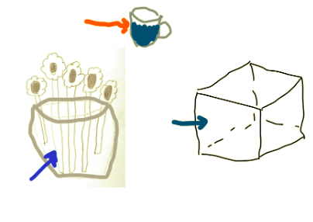
8.6.1 Warm-Up: Guess the Word
Micah and his family are playing a game in which each person chooses a card with a word written on it. Once a person chooses, they have one minute to draw a picture of the word. Then, his team guesses the word.
Micah chose the word “volume”. His drawing is shown.
volume 2, pg. 103

Slide 7
Choose the statement(s) that best describe volume. Select all that apply.
the sum of the length of all the edges of a three-dimensional object
the distance around a two-dimensional shape
the amount of three-dimensional space enclosed within a container
the total area of the surface of a three-dimensional object
the formula length times width times height
volume 2, pg. 103

Slide 8

Exploration
volume 2, pg. 103

Slide 9

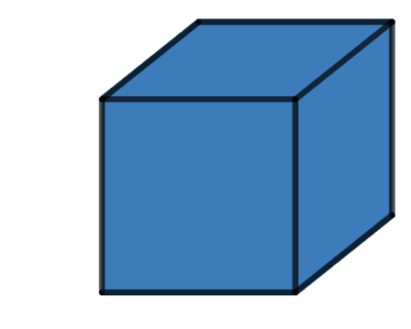




8.6.2 Exploration: The Unit Cube
Two images of the same cube are shown. The image on the right shows the coordinates of some of the edges of the cube.
$$(0, 1)$$
$$(−1, 0)$$
$$(−0.5, 0)$$
$$(0, 0)$$
volume 2, pg. 103

Slide 10
Share three things you know, two things you are not sure of, and one thing you have a question about.
I Know… | I’m Not Sure Of… | A Question I Have…
volume 2, pg. 103

Slide 11

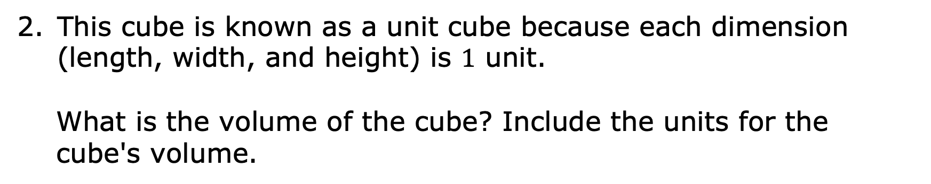
This cube is known as a unit cube because each dimension (length, width, and height) is $1$ unit.
What is the volume of the cube? Include the units for the cube's volume.
A cube is a rectangular prism with six congruent square faces.
volume 2, pg. 104

Slide 12
Exploration
volume 2, pg. 104

Slide 13
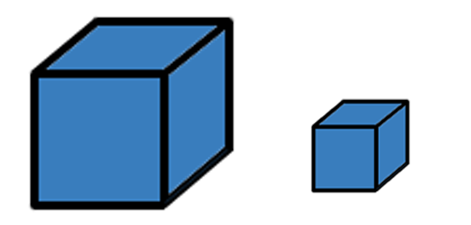
8.6.3 Exploration: Drawing Fractional Cubes
Two cubes are shown.
The cube on the left is a unit cube. The cube on the right has different dimensions.
volume 2, pg. 104

Slide 14
Share an observation and something you wonder about this new cube.
Observation | Wondering
volume 2, pg. 104

Slide 15
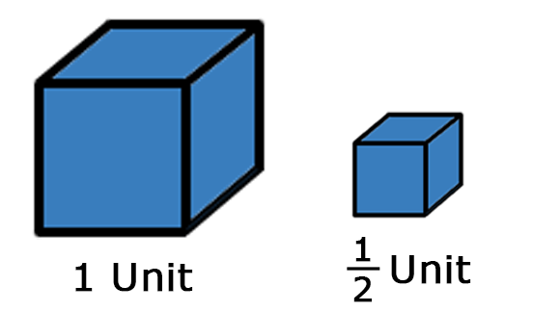
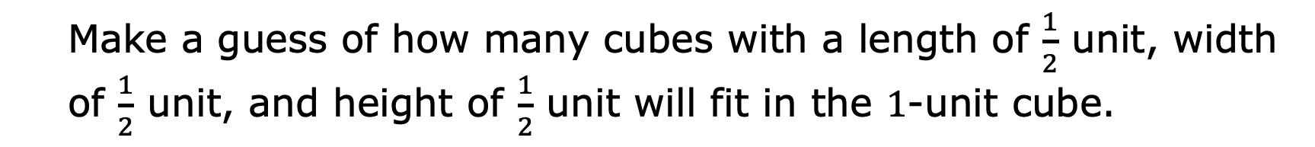
A unit cube and a half-unit cube are shown.
Make a guess of how many cubes with a length of $\frac{1}{2}$ unit, width of $\frac{1}{2}$ ​unit, and height of $\frac{1}{2}$ unit will fit in the $1$-unit cube.
volume 2, pg. 105

Slide 16
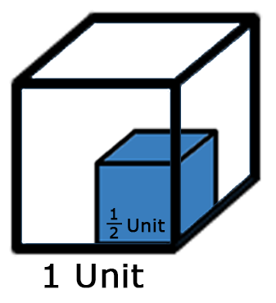
The figure shows a half-unit cube inside a unit cube.
Explain how the figure helps you to visualize how to pack cubes that have a fractional length.
volume 2, pg. 105

Slide 17
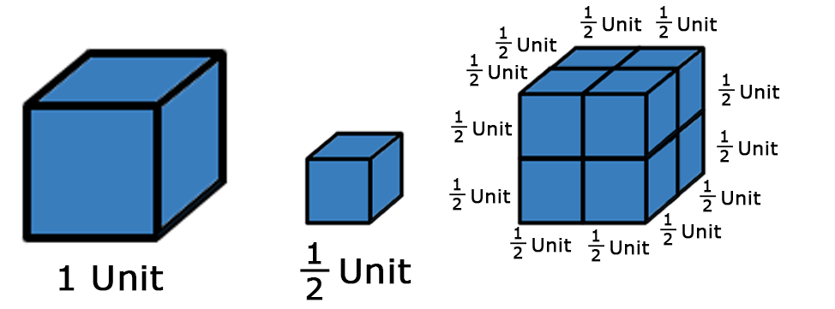
Three figures are shown.
Explain how the figures help you visualize how to pack cubes that have a fractional length.
volume 2, pg. 105

Slide 18
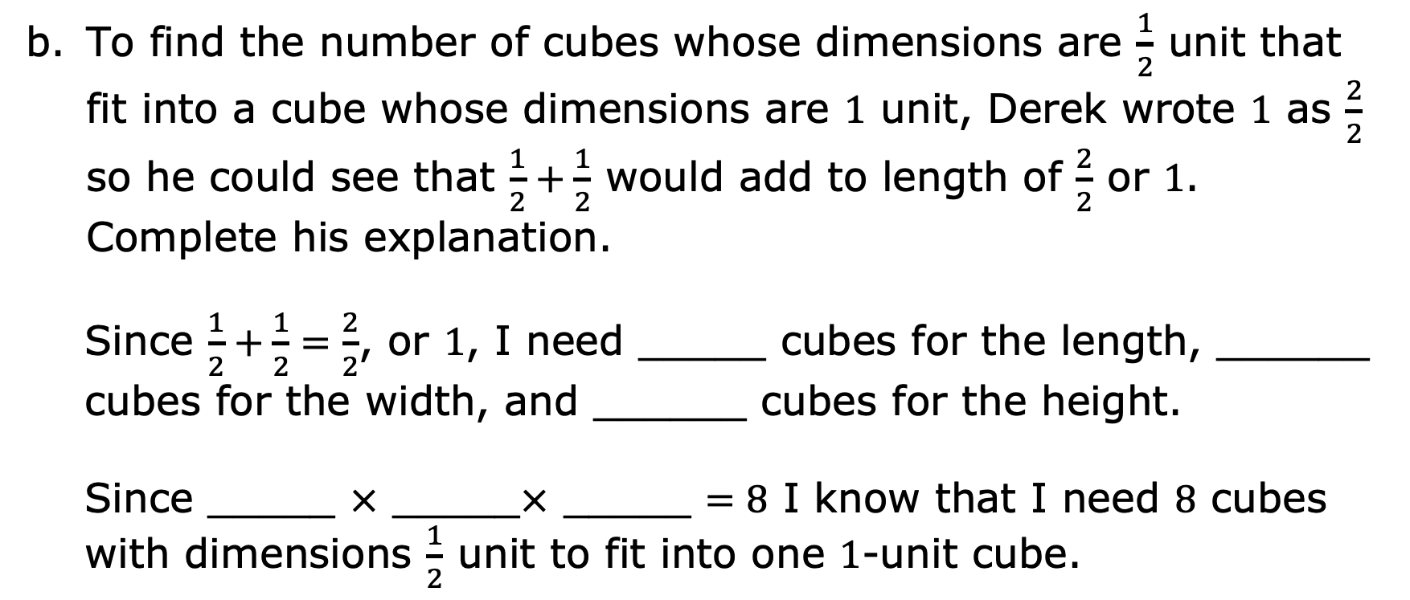
To find the number of cubes whose dimensions are $\frac{1}{2}$ unit that fit into a cube whose dimensions are $1$ unit, Derek wrote $1$ as $\frac{2}{2}$ so he could see that $\frac{1}{2}+\frac{1}{2}$ would add to length of $\frac{2}{2}$ or $1$. Complete his explanation.
Since $\frac{1}{2}+\frac{1}{2}=\frac{2}{2}$, or $1$, I need _____ cubes for the length, ______ cubes for the width, and ______ cubes for the height.
Since _____ $×$ _____$×$ _____ $=8$ I know that I need $8$ cubes with dimensions $\frac{1}{2}$ unit to fit into one $1$-unit cube.
volume 2, pg. 105

Slide 19

Guided Instruction
volume 2, pg. 106

Slide 20
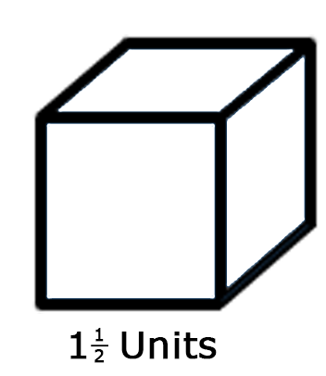
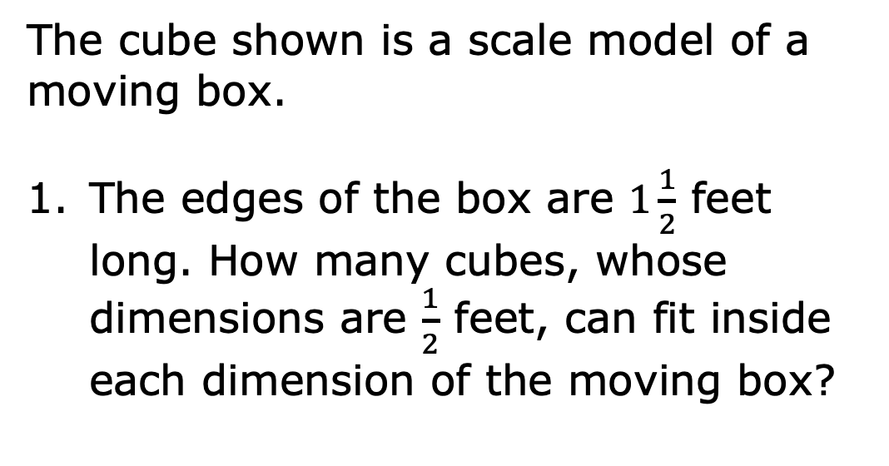
8.6.4 Guided Instruction: Volume with Fractional Cubes
The cube shown is a scale model of a moving box.
The edges of the box are $1\frac{1}{2}$ feet long. How many cubes, whose dimensions are $\frac{1}{2}$ feet, can fit inside each dimension of the moving box?
volume 2, pg. 106

Slide 21
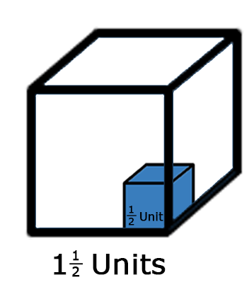
Sketch the cubes that can fit inside each dimension of the moving box.
volume 2, pg. 106

Slide 22
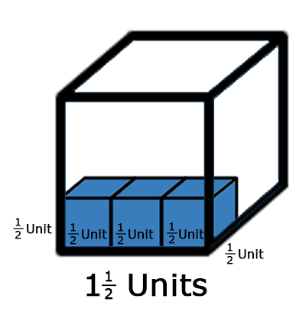
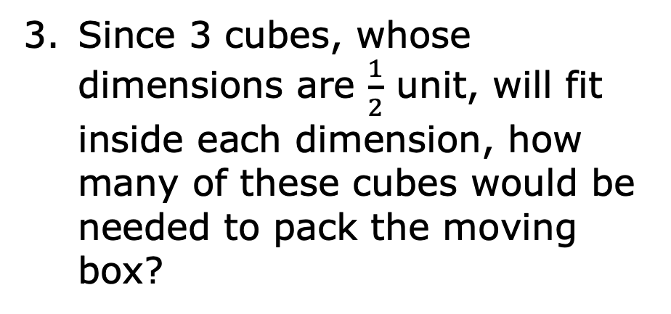
Since 3 cubes, whose dimensions are $\frac{1}{2}$ unit, will fit inside each dimension, how many of these cubes would be needed to pack the moving box?
volume 2, pg. 106

Slide 23
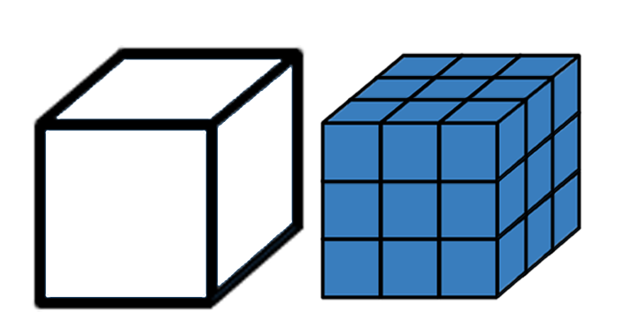
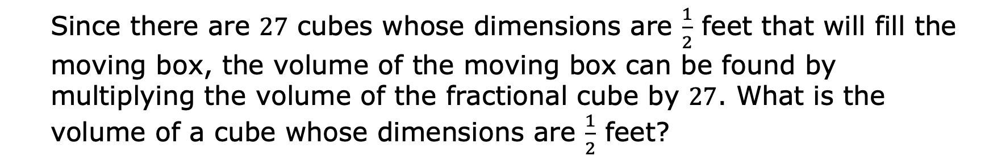
This cube is a scale model of a moving box. The edges of the box are $1\frac{1}{2}$ feet long.
Since there are $27$ cubes whose dimensions are $\frac{1}{2}$ feet that will fill the moving box, the volume of the moving box can be found by multiplying the volume of the fractional cube by $27$. What is the volume of a cube whose dimensions are $\frac{1}{2}$ feet?
volume 2, pg. 106

Slide 24
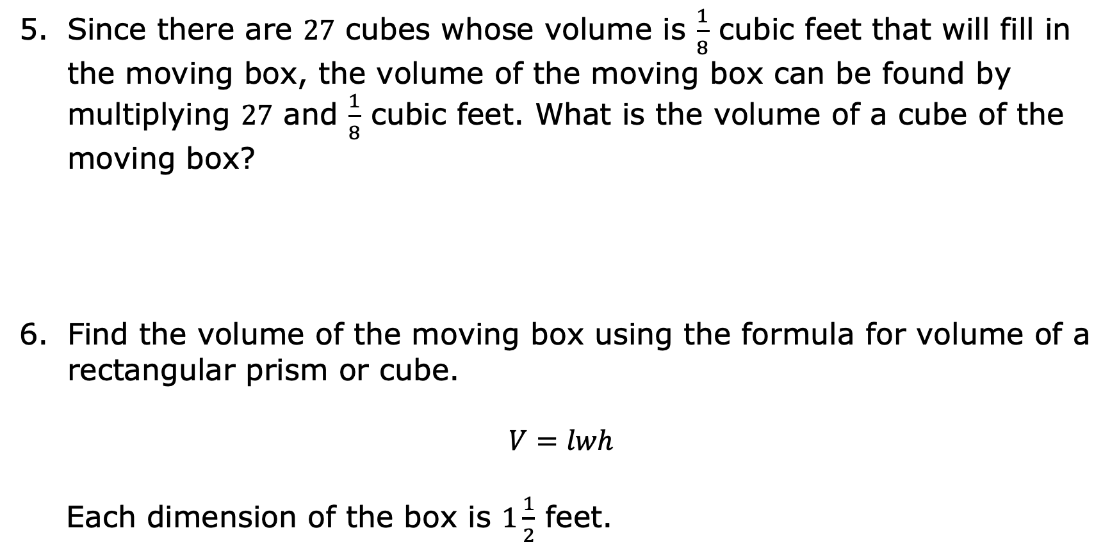
Since there are $27$ cubes whose volume is $\frac{1}{8}$ cubic feet that will fill in the moving box, the volume of the moving box can be found by multiplying $27$ and $\frac{1}{8}$ cubic feet. What is the volume of a cube of the moving box?
Find the volume of the moving box using the formula for volume of a rectangular prism or cube.
$$V=lwh$$
Each dimension of the box is $1\frac{1}{2}$ feet.
volume 2, pg. 107

Slide 25
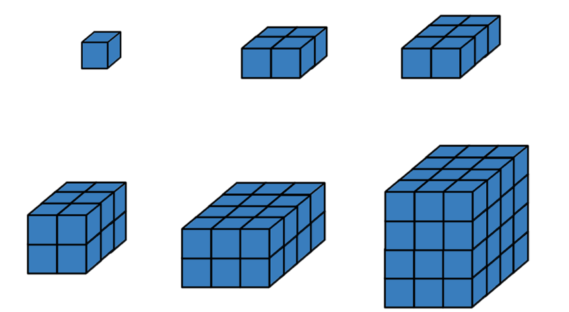
Does the volume you found using the formula match the volume you found by counting the number of fractional cubes?
The images show different rectangular prisms composed of various numbers of cubes.
volume 2, pg. 107

Slide 26
What do you notice?
Explain how the dimensions of the prism can be determined using the cubes shown if each small blue cube is 1 unit cube.
volume 2, pg. 107

Slide 27
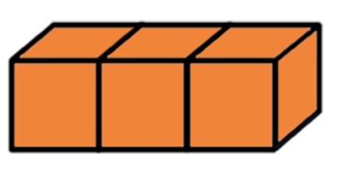
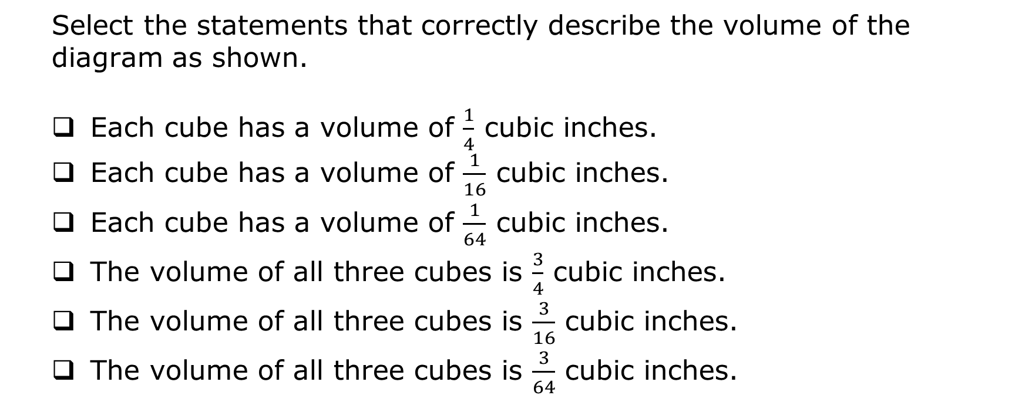
The diagram shows $3$ cubes whose dimensions are $\frac{1}{4}$ inches.
Select the statements that correctly describe the volume of the diagram as shown.
Each cube has a volume of ​$\frac{1}{4}$ cubic inches.
Each cube has a volume of ​$\frac{1}{16}$ cubic inches.
Each cube has a volume of ​$\frac{1}{64}$ cubic inches.
The volume of all three cubes is ​$\frac{3}{4}$ cubic inches.
The volume of all three cubes is ​$\frac{3}{16}$ cubic inches.
The volume of all three cubes is ​$\frac{3}{64}$ cubic inches.
volume 2, pg. 108

Slide 28
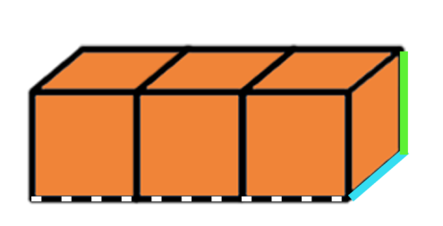
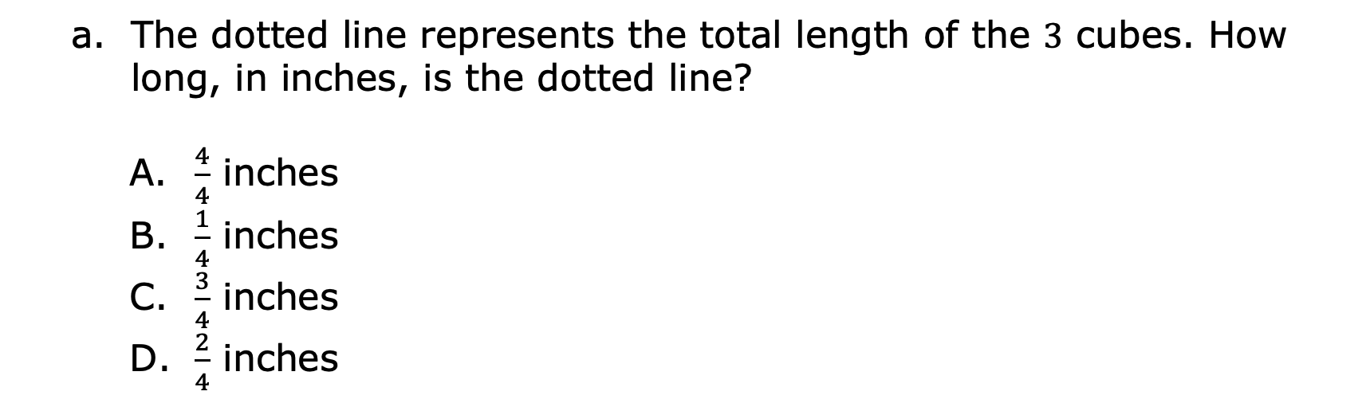
The same diagram of $3$ cubes whose dimensions are $\frac{1}{4}$ inches is shown.
The dotted line represents the total length of the $3$ cubes. How long, in inches, is the dotted line?
$\frac{4}{4}$ inches
$\frac{1}{4}$ inches
$\frac{3}{4}$ inches
$\frac{2}{4}$ inches
volume 2, pg. 108

Slide 29
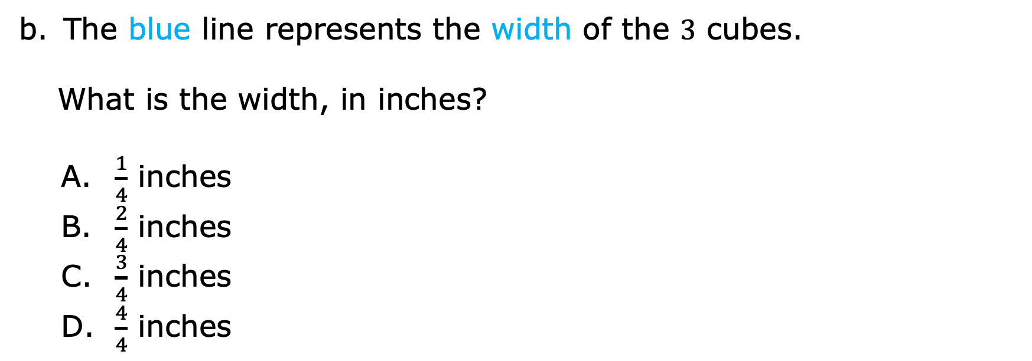
The blue line represents the width of the $3$ cubes.
What is the width, in inches?
$\frac{1}{4}$ inches
$\frac{2}{4}$ inches
$\frac{3}{4}$ inches
$\frac{4}{4}$ inches
volume 2, pg. 108

Slide 30
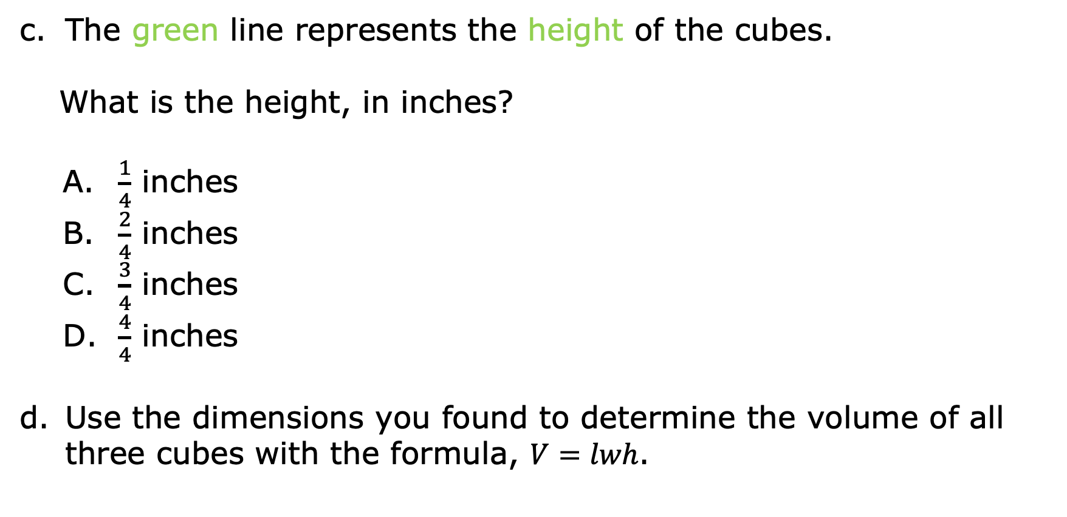
The green line represents the height of the cubes.
What is the height, in inches?
$\frac{1}{4}$ inches
$\frac{2}{4}$ inches
$\frac{3}{4}$ inches
$\frac{4}{4}$ inches
Use the dimensions you found to determine the volume of all three cubes with the formula, $V=lwh$.
volume 2, pg. 108

Slide 31
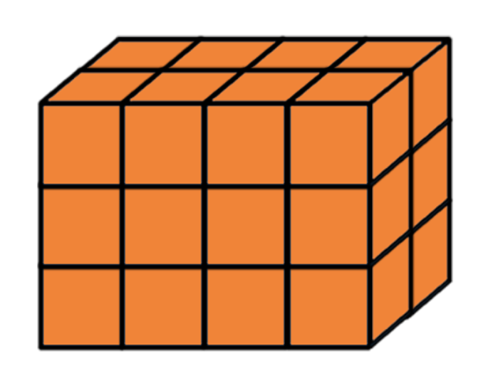
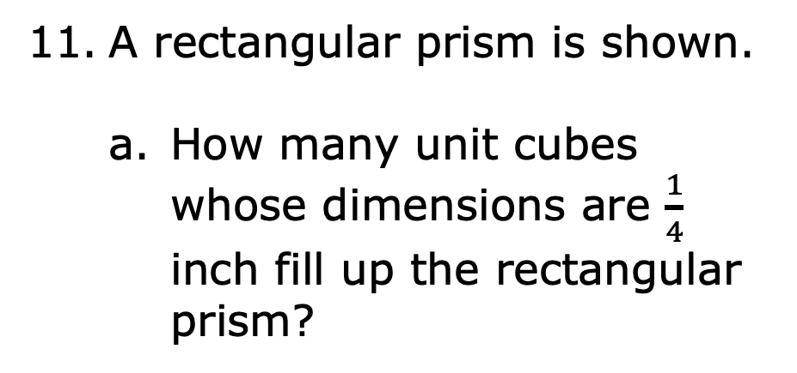
Finding volume using fractional unit cubes can be done by first finding the volume of one of the fractional unit cubes, and then multiplying that by the total number of fractional unit cubes.
A rectangular prism is shown.
How many unit cubes whose dimensions are $\frac{1}{4}$ inch fill up the rectangular prism?
volume 2, pg. 109

Slide 32
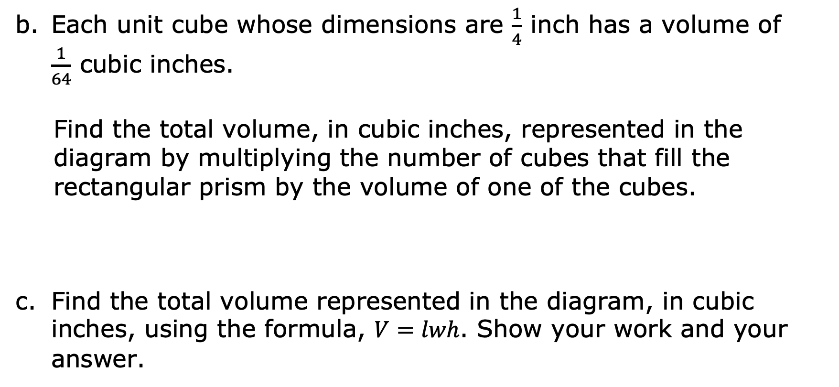
Each unit cube whose dimensions are $\frac{1}{4}$ ​inch has a volume of $\frac{1}{64}$ ​cubic inches.
Find the total volume, in cubic inches, represented in the diagram by multiplying the number of cubes that fill the rectangular prism by the volume of one of the cubes.
Find the total volume represented in the diagram, in cubic inches, using the formula, $V=lwh$. Show your work and your answer.
volume 2, pg. 109

Slide 33

Your Turn
volume 2, pg. 109

Slide 34
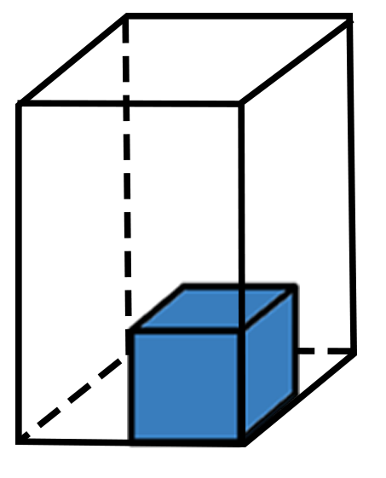
8.6.5 Your Turn!
A rectangular prism with one cube inside is shown.
How many cubes will it take to fill the rectangular prism?
volume 2, pg. 109

Slide 35
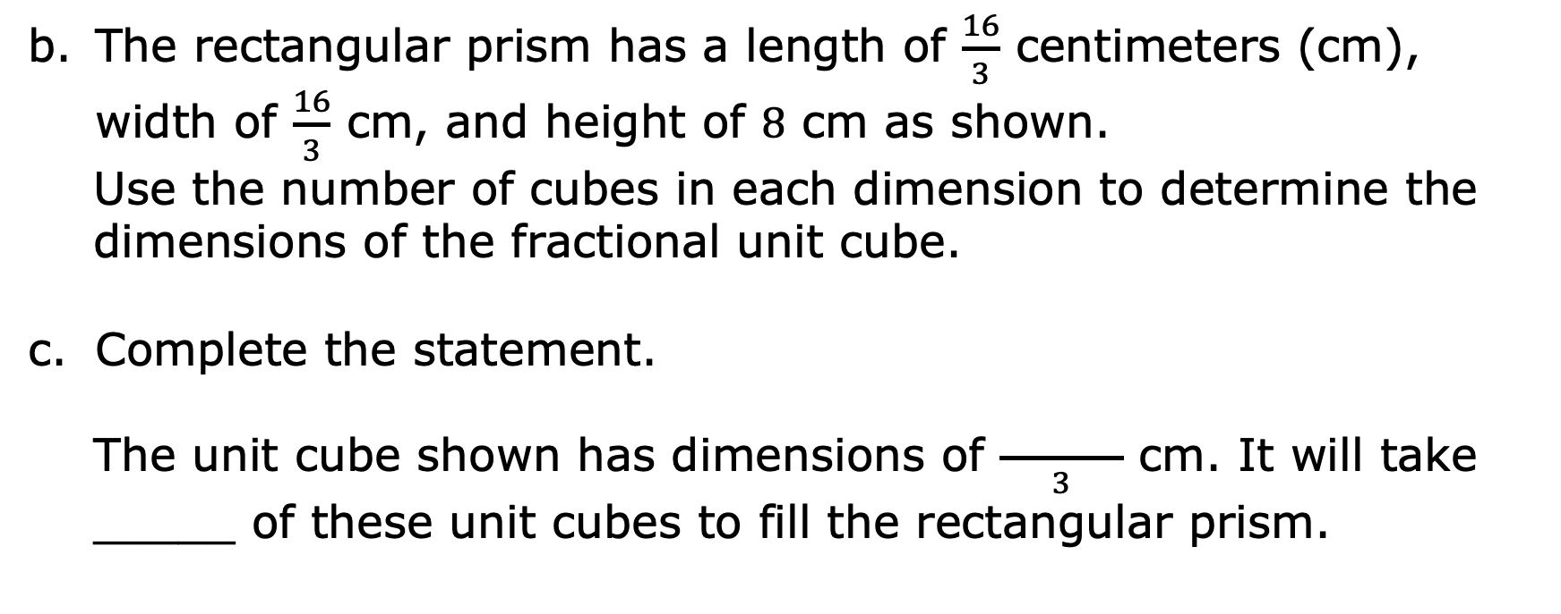
The rectangular prism has a length of $\frac{16}{3}$ centimeters (cm), width of $\frac{16}{3}$ cm, and height of $8$ cm as shown.
Use the number of cubes in each dimension to determine the dimensions of the fractional unit cube.
Complete the statement.
The unit cube shown has dimensions of $\frac{ }{3}$ cm. It will take _____ of these unit cubes to fill the rectangular prism.
volume 2, pg. 109

Slide 36
Explain how to find the volume of the rectangular prism using the information from Part C.
volume 2, pg. 109

Slide 37

Wrap-Up
volume 2, pg. 110

Slide 38
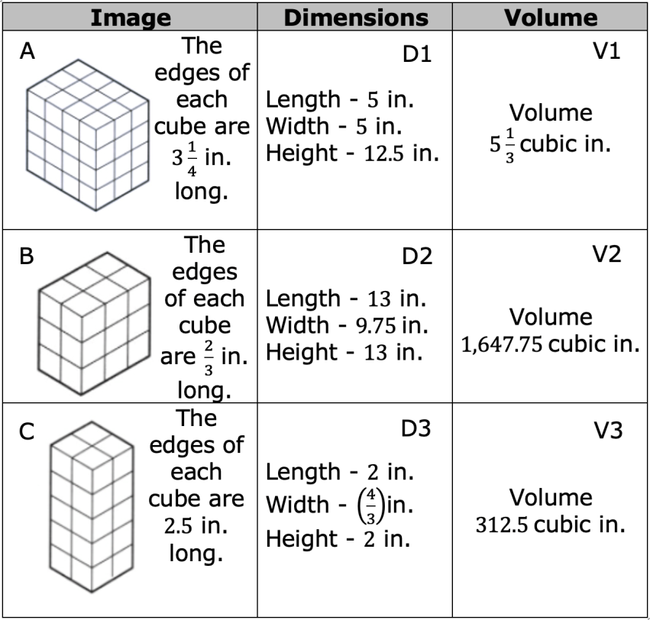
8.6.6 Wrap-Up: Ticket Out the Door
Match each image with its corresponding dimensions and volume. Use the table below to record your answers.
volume 2, pg. 110

Slide 39
Image | Dimensions | Volume
A
B
C
volume 2, pg. 110

